Slide 1

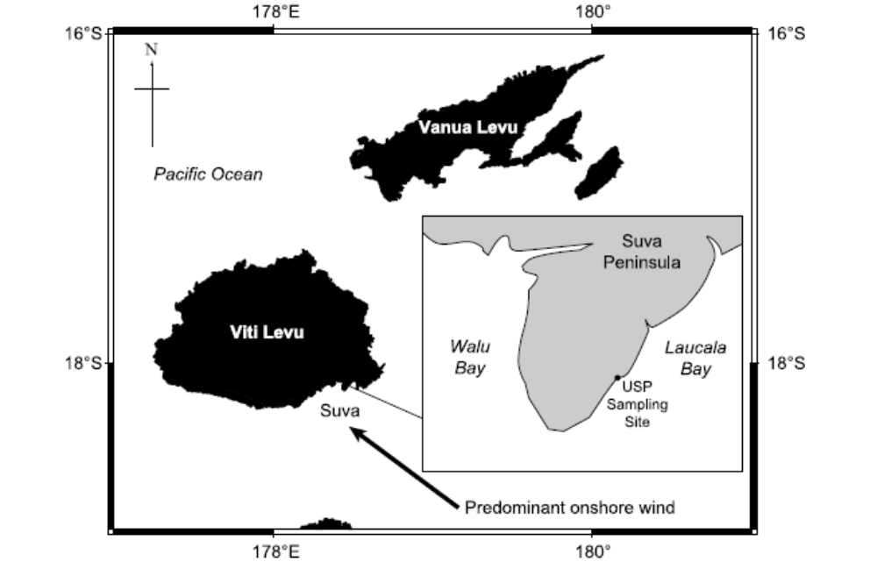
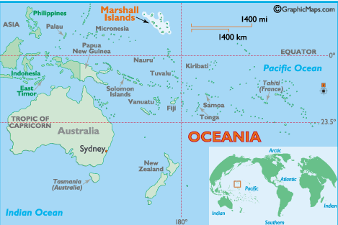
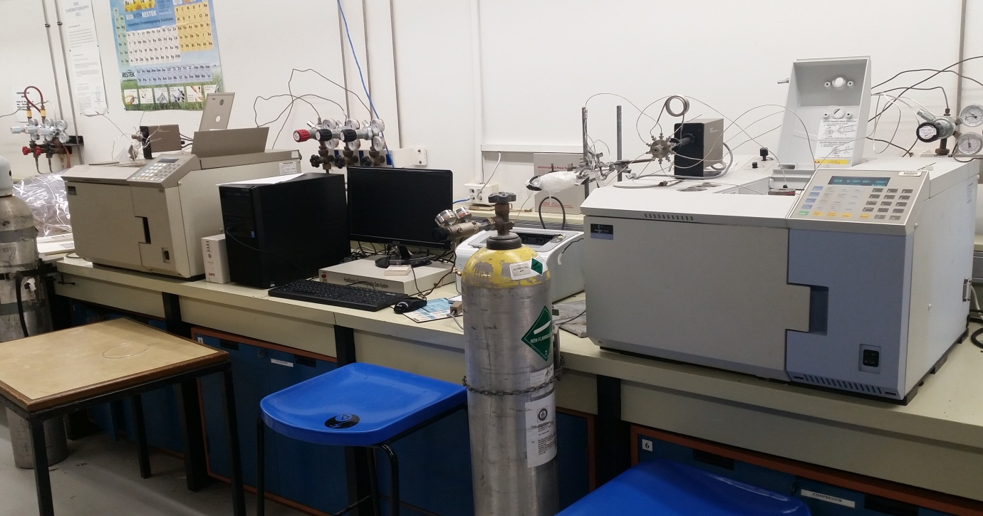
Atmospheric CH₄ and N₂O measurements at Suva, Fiji
Francis S. Mani^{1*}, Deepitika Chand¹, Zahra Nizbat¹ and Matakite Maata¹
¹School of Biological and Chemical Sciences, Faculty of Science, Technology and Environment, The University of the South Pacific, Suva, Fiji.
*Corresponding author: mani_f@usp.ac.fj
Introduction
In-house capacity was developed at the University of the South Pacific to measure ambient methane and nitrous oxide mixing ratios at a clean air site located in Suva, Fiji Islands (18°08′S, 178°26′E).
Figure 1: A map of the Oceania region showing Fiji and location of the sampling site in Suva.
In 1994 in collaboration with National Institute of Water and Atmospheric Research (NIWA), an air sampling station was set-up to determine background levels of atmospheric methane mixing ratios and δ¹³C(CH₄). This project was discontinued in 2003 but in 2016 the monitoring station was revived with the help of NIWA to collect samples and measure CH₄ and N₂O in the chemistry laboratory at USP. This could be an important site that could contribute significantly to Global Atmosphere Watch (GAW) programme by providing high resolution data and interpretation of seasonal cycles in mixing ratios that can be compared to other sites and particularly sites in extra-tropical Southern Hemisphere like South Pole in Antarctica. Fiji experiences special meteorological conditions like movement of Inter Tropical Convergence Zone (ITCZ), South Pacific Convergence Zone (SPCZ) and Southern Oscillation Index (SOI) that affect the transport and hence variability in atmospheric composition of these gases .
Results
Figure 3 shows the atmospheric mixing ratios of CH₄ at Suva from 1994 – 2003 measured at NIWA. Due to complex tropical meteorology there is sporadic intrusion of polluted northern hemispheric air (circled above) and this has been confirmed by the Unified Model and isotopic δ¹³C of CH₄.
Figure 4
Figure 4 above shows the atmospheric mixing ratios of CH₄ at Suva from Sept 2016 – August 2017 measured at USP. In comparison to SPO data it does show a sinusoidal shape with a minima in summer and maxima in spring. However the values obtained for the recent months are higher than what were observed at SMO last year for the same month. The seasonal amplitude is about 50 ppbv which is slightly larger and may suggest some localized emissions influencing methane mixing ratios at the sampling site.
Methodology
Air samples were collected in a 2L stainless steel canisters to a pressure of 2 bars.
The air samples were measured using GC-FID for CH₄ and GC-ECD for N₂O. For N₂O measurements the ECD detector was doped with 10 % carbon dioxide to increase its sensitivity whilst using nitrogen gas as a carrier gas.
The air samples were dried using a magnesium perchlorate trap before injection. Both systems used a backflush reversal technique using a pre-column and an analytical column. Molecular Sieve columns were used for CH₄ and Porapak-Q columns were used for N₂O measurements.
The precision of measurement is 4 ppbv for CH₄ and 2 ppbv for N₂O.
Figure 5
Figure 5 shows the novel measurements of N₂O from Suva measured at USP. The N₂O measurements are around 330 ppbv and shows variability in data as compared to SMO and SPO sites. This suggest either more method development is required or influences of some localized emissions at the sampling site.
Conclusion & Recommendations
Fiji demonstrates an excellent site to measure atmospheric composition of trace gases as it is influenced by complex tropical meteorology and long range transport of pollutants from biomass burning in Australia. Although USP has demonstrated its capability in measuring CH₄ and N₂O, further method developments are required to enhance the time series obtained for background clean air site:
Installation of weather station that records wind direction and wind speed and will only allow for clean air that has not made any landfalls to be sampled.
Inter-laboratory comparison is important to ensure validity.
A moisture trap to be used during sampling as the environment is very humid and this could affect the performance of GC detectors.
Figure 2: The Trace Gas Laboratory at the University of the South Pacific housing the two GC systems.
Acknowledgement
The authors would like to thank Dr. Michael Harvey, Mr. Gordon Brailsford and Mr. Anthony Bromley for providing their valuable support in method developments at USP and also for providing calibration standards. The authors would also like to thank USP faculty research committee for funding this work.

