Slide 1
Exploring the Impact of COVID-19 on the Tourism Industry of Fiji, Solomon Islands and Samoa
Presenter: Sunil Kumar
Team Members: Suwastika Naidu, Atishwar Pandaram, Jone Lako & Sahlni Devi

Slide 2
Outline of the Presentation
1.0 Introduction
2.0 Background of COVID-19 in the Pacific Island Countries (PICs)
3.0 COVID-19 Economic Trends in Fiji, Samoa and the Solomon Islands
4.0 Status of COVID-19 Cases in Fiji, Samoa and Solomon Islands
5.0 Direct Impact of COVID-19 on the Tourism Sector of Fiji, Samoa and the Solomon Islands
6.0 National Governments Fiscal Stimulus Package to Revitalize the Contracting Economy
7.0 Tourism Related Recovery Policies
8.0 Conclusion and Policy Options

Slide 3
1.0 Introduction
Covid-19 hit PICs in around late March of 2020 when some cases were detected and visitor arrivals into Fiji dropped sharply.
Significant Restrictions were placed on Movement:
  In Hospitals and key Government enclosures;
  Social distancing rules were put in place;
  Closure of international borders and quarantine measures were established;
  By April 2020 - PICs came under full grips of the restrictions.
Countries relying heavily on Tourism were hit hard from the downturn;
Tourism Related services were equally affected;
PICs are now facing deep economic contraction this year with expected economic contract of more than -5.5% in the year 2020 (IMF, 2020).
Global Economy expected to decline by around 4.4% (As per October IMF est.)

Slide 4
2.0 Background of COVID-19 in the Pacific Island Countries (PICs)
Figure 1: Real GDP Actual and Latest Projects
Average Real GDP of the PICs is expected to significantly fall from 2.2% in the year 2019 to -5.5% in the year 2020.
Source: IMF (2020)

Slide 5
3.0 Projected Economic Trends for Fiji, Samoa and the Solomon Islands
Table 1: Actual and Projections of Real GDP
Pacific Island Countries (PICs) | 2019 (%) | 2020 (%) | 2021 (%)
Fiji (Highly Dependent on Tourism) | -1.3 | -19.5 (RBF) 21% (IMF) | 11.5
Palau | -1.8 | -11.4 | -7.4
Vanuatu | 3.3 | -8.3 | 4.3
Samoa | 3.5 | -5 | -1.5
Solomon Islands | 1.2 | -5 | 4.5
Marshall Islands | 5.3 | -4.5 | -0.9
Micronesia | 1.2 | -3.8 | 1.2
Papua New Guinea | 4.9 | -3.3 | 1.2
Tonga | 0.7 | -2.5 | -3.5
Kiribati | 2.3 | -1.1 | 3
Tuvalu | 6 | -0.5 | 3
Nauru | 1 | 0.7 | 1.3
Source: RBF (2020); IMF (2020)

Slide 6
3.0 Current Account Balance (% Of GDP)
Table 2: Current Account Balance (% of GDP)
Pacific Island Countries (PICs) | Year
 | 2019 | 2020 | 2021
Fiji | -12.9 | -15.3 | -12.1
Samoa | 2.3 | -7.1 | -7.0
Solomon Islands | -9.6 | -11.3 | -16.4
Source: IMF (2020)

Slide 7
3.0 Fiscal Account Balance (% of GDP)
Table 3: Fiscal Account Balance (% of GDP)
Pacific Island Countries (PICs) | Year
 | 2019 | 2020 | 2021
Fiji | -5.1 | -19.2 | -9.0
Samoa | 2.7 | -7.3 | -9.8
Solomon Islands | -1.7 | -5.6 | -4.9
Source: IMF (2020)

Slide 8
4.0 COVID-19 Cases in THESE PICs
The outlook as per now looks good once international travel opens up, the situation could worsen drastically. Therefore, vaccine availability for PICs would be a crucial issue early 2021.
Table 4: COVID-19 Situation in Fiji, Samoa and the Solomon Islands
Country | Total Confirmed Cases | Total Confirmed Deaths | New Confirmed Cases | Proportion of Fatal Cases % | Confirmed cases from the past 7 days | Confirmed cases from the past 14 days
Fiji | 35 | 2 | 1 | 5.88% | 0 | 1
Samoa | 1 | 0 | 0 | 0% | 1 | 1
Solomon Islands | 17 | 0 | 1 | 0% | 1 | 1
Updated as of 24 November 2020, 10:00 GMT+8
Source: WHO (2020) and other sources.

Slide 9
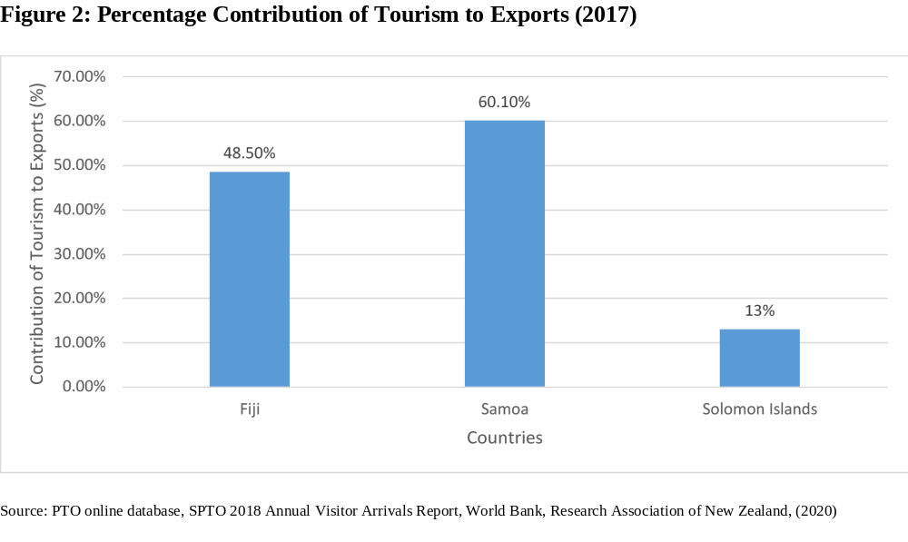
5.0 Direct Impact on the Tourism Sector OF PICs
In the year 2017, the tourism sector of Samoa contributed 60.1% to the exports followed by 48.5% to the exports of Fiji and 13.0% to the exports of the Solomon Islands.

Slide 10
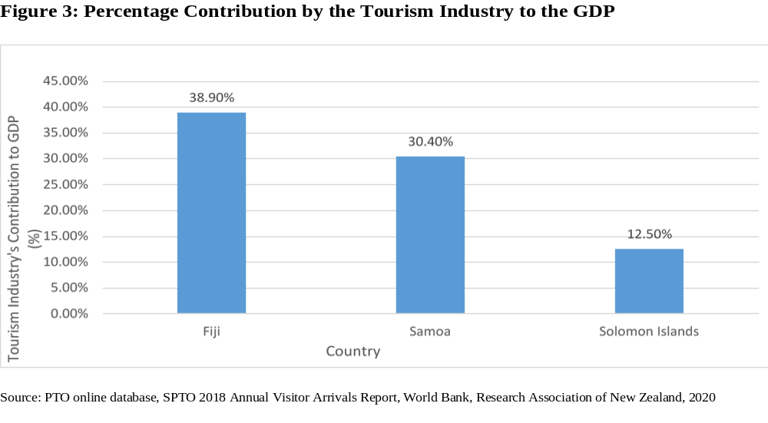
5.0 Percentage Contribution by the Tourism Industry to the GDP
In the year 2018, the tourism industry of Fiji contributed 38.9% to the GDP, followed by 30.4% to the GDP of Samoa and 12.5% to the GDP of the Solomon Islands.

Slide 11
TOURISM ORIENTED COUNTRIES
Fiji and Vanuatu are the worst affected whereas Samoa was moderately affected and Solomon Islands least affected
From solid growth in January and February, tourist departures from Australia to Fiji and Vanuatu— the two main destinations for Australian tourists in the South Pacific—fell by 29.2% and 41.2%, respectively, in March 2020. By April, Fiji only received only about 80 arrivals from Australia, while Vanuatu recorded none. Total travel lockdown came into effect post-April 2020, which continues to date with some exceptions of medical emergencies.

Slide 12
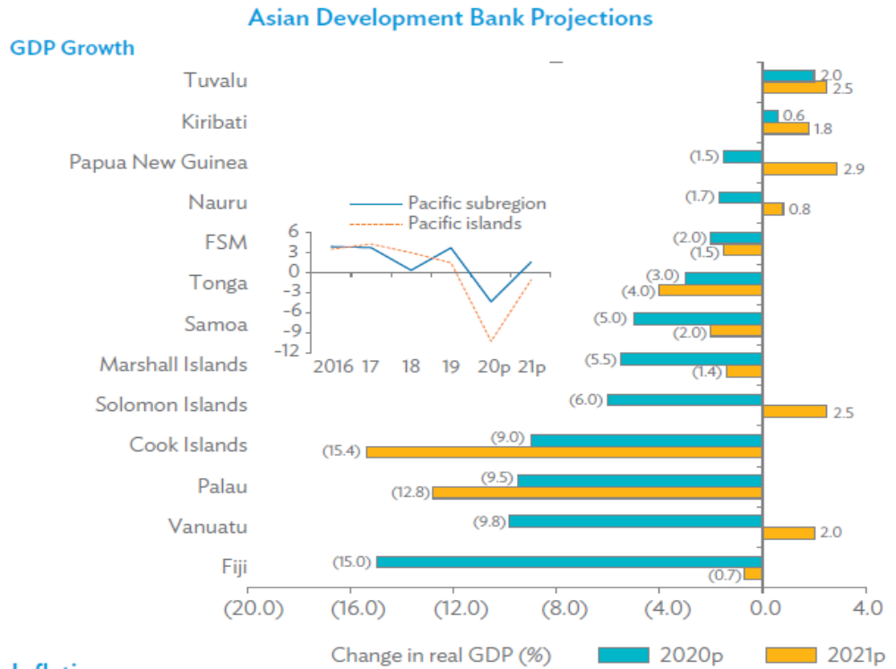
ADB Projections Shown Graphically
Some Observations
Fiji’s Growth projection of 11% for 2021 (by IMF) looks good but depends on the revival of the tourism sector.
Palau and Cook Islands are likely to contract significantly in 2021.
Solomon Islands (Non-tourism country) is poised to grow by around 2.5% (4.5% as per IMF) in 2021.
Similarly, PNG (A non-tourism country) is poised to grow by around 3% (1.2% as per IMF) in 2021.

Slide 13
5.0 Direct Impact of COVID-19 on the Tourism Sector of Fiji, Samoa and the Solomon Islands
Table 8: Visitor Arrivals by Destination Country (Based On 12-Month Percentage Change)
Country | Q4 2019 | Q1 2020 | Q2 2020 | Q3 2020 | Sept 2020
Fiji | -0.4 | -18.7 | -99.2 | -99.0 | -98.8
Solomon Islands | 13.8 | -36.3 | -100 | -100 | -100
Samoa | -10.7 | -36.2 | -100 | -100 | -100
Micronesia | -0.6 | -24.3 | -100 | -100 | -100
Palau | 22.6 | -30.7 | -100 | -100 | -100
Papua New Guinea | -0.8 | -17.9 | -98.1 | -97.3 | -96.9
RMI | 2.5 | -20.9 | -100 | -100 | -100
Tonga | 30.8 | -41.3 | -100 | -100 | -100
Tuvalu | 8.8 | -22.3 | -100 | -100 | -100
Vanuatu | 11.0 | -2.0 | -100 | -100 | -100
Kiribati | 16.9 | -35.3 | -100 | -100 | -100
Source: IMF (2020)

Slide 14
5.0 Fiji’s TOURISM Case – some details
In late March 2020, the Fiji Hotels & Tourism Association announced 93% closure of operations decline in the tourist numbers.
According to ADB, Fiji’s tourism industry is likely to return to the pre-COVID levels by 2023. However, much depends on how the vaccine is made available in the region (including Australia and New Zealand).
As per July 2020 IFC survey, 50% of tourism businesses are currently in hibernation and or fully shut down while 35% are operating at reduced hours.

Slide 15
Solomon Islands Case
Similarly in Solomon Islands businesses are either hibernating or completely shut down.
From January to March 2020, the tourism declined sector in Solomon Islands declined to 50% in revenues (Lilomo, 2020).
Beyond April 2020, the major hotels in the Solomon Islands experienced low occupancy of around 10% to 18% (Lilomo, 2020).
This is expected to continue until the global situation normalizes.

Slide 16
Samoa’s Case
Tourism Earnings and Remittances declined by more than 60% in March 2020 (Samoa Bureau of Statistics, CBS (Fruean, 2020).
As everywhere else the situation worsened beyond 90% once the global restrictions cam into effect post-April 2020 (Fruean, 2020).
The situation continue now and expected to remain until mid 2021.

Slide 17
6.0 Fiji - National Governments Fiscal Stimulus Package to Revitalize the Contracting Economy
In March 2020 the Fijian government announced Covid-19 Budget to adjust allocations to the 2019-20 National Budget. Under this adjustment new allocations to the health sector were considered to address the pandemic related expenditures.
Under the government announcements, the Fiji National Provident Fund was allowed to release its funds to cater for those who lost their jobs. Around FJ$1 billion was earmarked for this purpose, which included government borrowing.
The ADB increased its funding by another FJ$100 million and the World Bank provided a facility of FJ$5.5 million.
Australia and New Zealand also made substantial amount of funds to the Fijian Government. Initially a total of approximately FJD 7million was made available by Australian and New Zealand.
Additional FJ$23million was provided by Australia and New Zealand.

Slide 18
6.0 Fiji 2020-21 National Budget (Fiscal Stimulus package to revitalize the contracting economy)
To ease the cost pressure on businesses, the mandatory FNPF employer and employee contributions were reduced to 5% for the period starting from the start of April – December 2020.
From 1 February 2020, the workers who had lost their jobs or were working for reduced hours were allowed to withdraw FJ$1000 from their FNPF accounts.
Employees who were adversely affected by the COVID-19 restrictions were able to withdraw an initial amount of FJ$500 from their FNPF accounts.
New funding measures were made available for businesses to create new employments. These were made available through credit assistance by the Reserve Bank of Fiji and funding by the Fiji Customs and Revenue Authority.
A number of new measures were taken by the government to create employment through business assistance schemes.

Slide 19
6.0 Samoa - National Government’s Fiscal Stimulus Package to Revitalize the Contracting Economy
Table 9: Samoan Stimulus Package to Help Mitigate the Adverse Impacts of COVID-19
Funds | Areas
$20.3million | Health Sector Response
$12.5million | Private Sector Enhancement
$2.5million | Coronavirus initiative
$27.5million | To Households - Increasing the purchasing power of Samoans
$3.5million | Ministry of Agriculture and Fisheries
Source: Government of Samoa, (2020a)

Slide 20
6.0 Solomon Islands - National Governments Fiscal Stimulus Package to Revitalize the Contracting Economy
Table 10: Solomon Islands Stimulus Package to Increase Aggregate Demand
Funds | Areas
$5 million | Monitoring State of Emergency Regulations
$5 million | Rental Relief Package
$10 million | Health grants
$5 million | Education support
$39 million | Infrastructure investment in wharfs
$39 million | Construction of major
$39 million | Upgrading of domestic ports
Source: Solomon Islands Government. (2020)

Slide 21
7.0 Tourism Related Recovery Policies
Strong and Sensible national leadership is needed in PICs to address the current problems and to plan for the future;
The workforce capabilities in PICs would need a new direction to enhance skills;
The tourism sector would need special attention in Fiji and Samoa
Solomon Islands would need new directions in Agriculture and Government service
The whole PIC region would need to develop new tourism products with possible rejuvenated health facilities.

Slide 22
Tourism Related Recovery Policies
Regional leadership is needed to develop Pacific bubble to ensure that our borders open much earlier than expected to reduce the negative repercussions of the COVID-19 pandemic on the tourism industry in PICs.
Scenario planning and provision of information are essential to support the successful implementation of tourism industry recovery plans.
New forms of immediate support would be needed (for example, microfinancing schemes) to help businesses survive the current negative repercussions (Research Association of New Zealand, 2020).

Slide 23
7.0 Tourism Related Recovery Policies
The decline in employer and employee contributions to the National Provident Fund need to be reconsidered as soon as normalcy sets in.
Governments need to apply new policies to align the banking system towards a greater flexibility in the loan rates and repayments (particularly relating to micro, small and medium enterprises).
Domestic demand for imports should be substituted by increasing domestic demand for locally produced products. Importing policies need to be revitalised
This involves investing in agriculture and agri-business ventures.
Trade facilitation needs concerted efforts by the PIC governments.

Slide 24
8.0 Conclusion
COVID-19 crisis has brought forward new challenges for the world but more so for PICs.
Pics need to revitalize their domestic economies and rely less on inflows (remittances) and international tourism.
However, these sectors need to be made more competitive and self-reliant
Commodity manufacturing and trading may need a renewed attention among PICs despite their smallness.
The PICs need to generate regional synergy to counter the negative repercussions of such crisis on PICs.

Slide 25
References
IMF. (2020). No Tourism Recovery in September. Retrieved fromhttps://www.imf.org/en/Countries/ResRep/PIS-Region
IMF. (2020). Pacific Islands Monitor: Issue 13. Retrieved fromhttps://www.imf.org/en/Countries/ResRep/PIS-Region
Lilomo, P. (2020). COVID-19 Casting a Dark Shadow on Solomon Islands Tourism. Retrieved from https://www.solomontimes.com/feature/covid19-casting-a-dark-shadow-on-solomon-islands-tourism/459
Research Association of New Zealand. (2020). Pacific Tourism: COVID-19 Impact and Recovery. Retrieved from https://corporate.southpacificislands.travel/wp-content/uploads/2020/05/Pacific-Tourism-Sector-Status-report-Final.pdf

