Slide 1
Conquering the Oceanic Divide: 12 Centers
One Link – ICT
Dr Shaneel Chandra
School of Biological and Chemical Sciences, Faculty of Science, Technology & Environment
The University of the South Pacific
Suva, FIJI

Slide 2
Distance Learning
Learning attained by a student without a teacher’s physical presence to aid in the process.

Slide 3
Push factors
Innovations in technology
  the satellite, computer, Internet, microcomputer
    Delivery of content
    Communication and discussion, allowing feedbacks
Often the only viable option for reaching:
  Dispersed groups of students/those in remote areas
  Those seeking a cost-effective and convenient means for learners, who cannot study fulltime.
  Other benefits: wider deliverability, convenience etc.

Slide 4
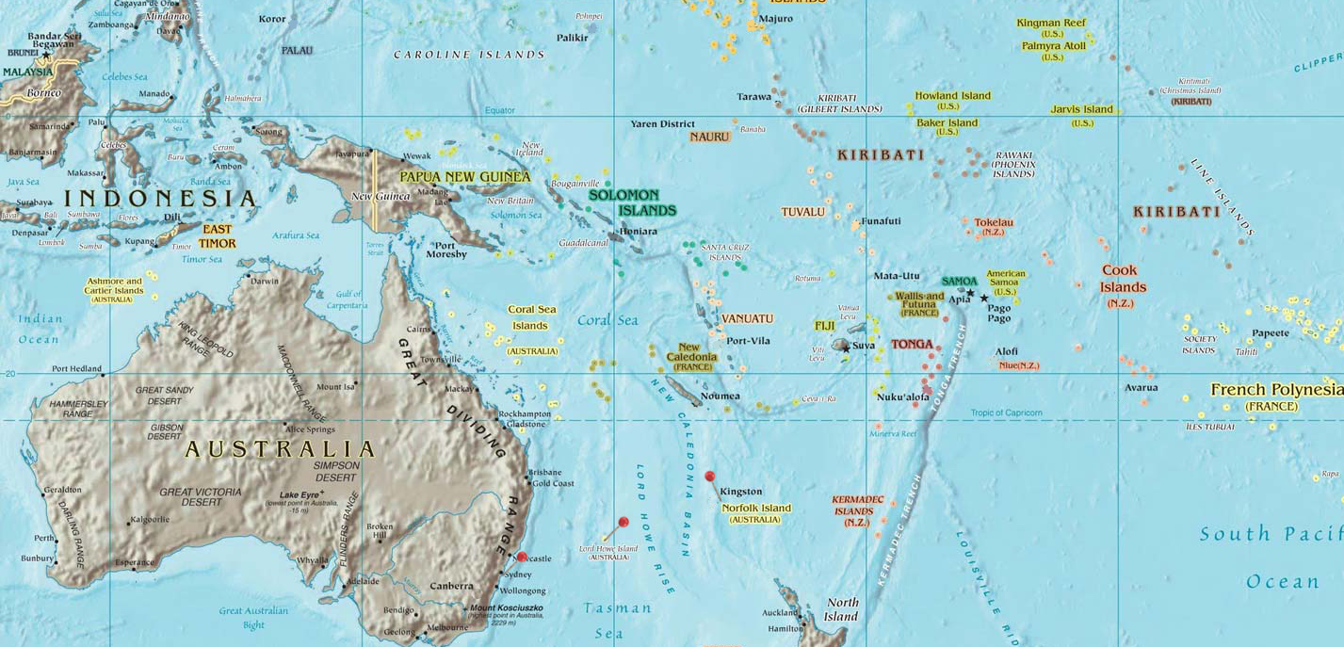
12 Nations, One People

Slide 5
Studying at the USP
20,000 enrollments (2012) through
  face-to-face mode
  print mode
  online.
More than half preferred Print Mode using
  Satellite communications
  Moodle.
- conventional learning
- distance learning

Slide 6
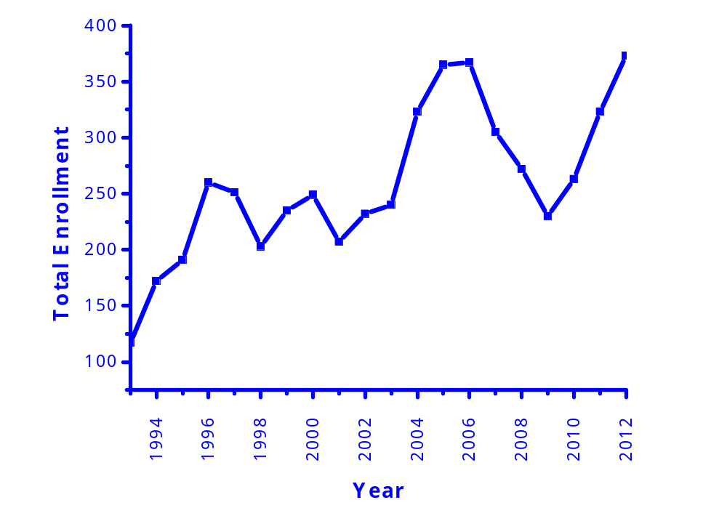
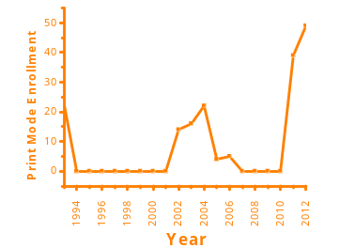
CH 101 Chemical Principles
2012 enrollments totaled 374
Team-taught course
8 hours/week contact
  Lectures: 3 x 50 min
  Tutorial: 1 x 50 min
  Practical: 3 x 50 min
Additional readings & learning support

Slide 7
Face-to-Face Teaching & Learning
Lectures delivered using:
  MS Powerpoint®
  OHP
  Whiteboard
Weekly tutorials accompanying lecture content.
  Inquiry-based learning encouraged.
  Additional support provided through student consultations.
Laboratory sessions enable application.

Slide 8
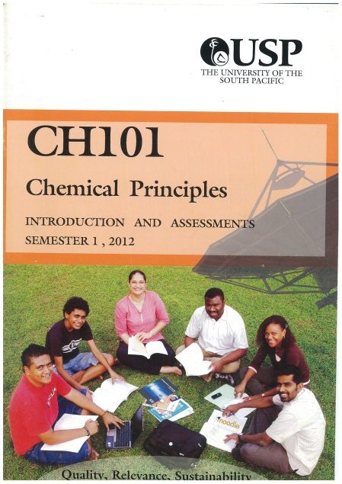
Print Mode Teaching & Learning
Reading material comes in Reader.
Tutorials & revision content separately in I&A Book.
Study Guide lists topics to study on a weekly basis.
Fortnightly satellite tutorial from Suva to each center with students.
Vacation laboratory sessions run by local tutor/campus visit.

Slide 9
Internet platforms – Moodle®
In 2012, Moodle handled
  Lecture notes
  Extra readings
  Tutorials
  Practical session handouts
  Discussion forums
  Mass email platform
  Assessment and grading

Slide 10
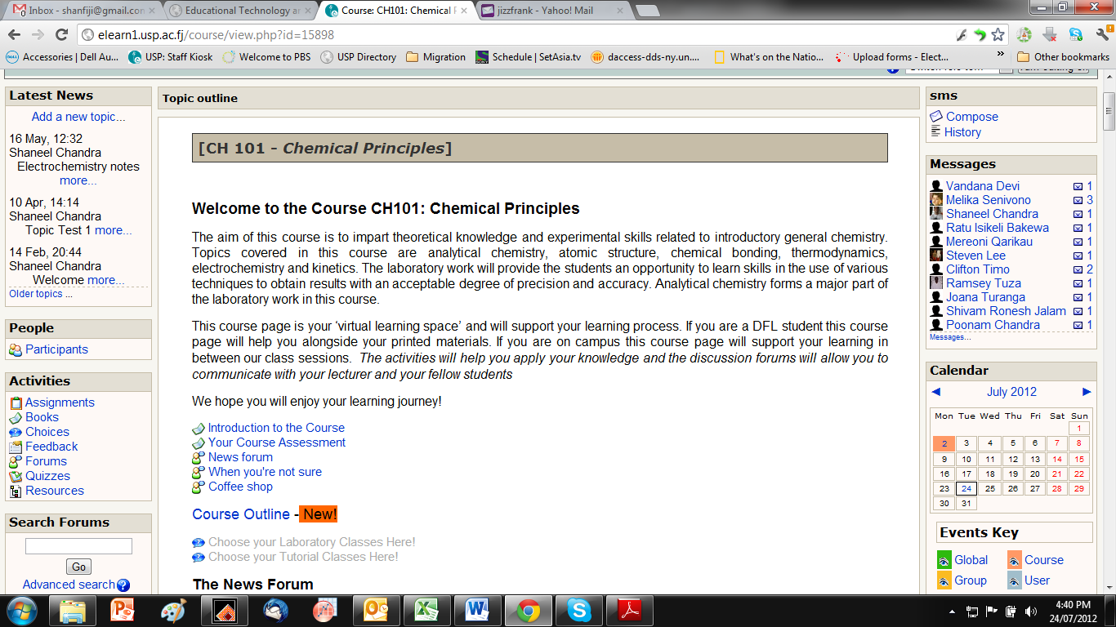
Moodle screenshots

Slide 11
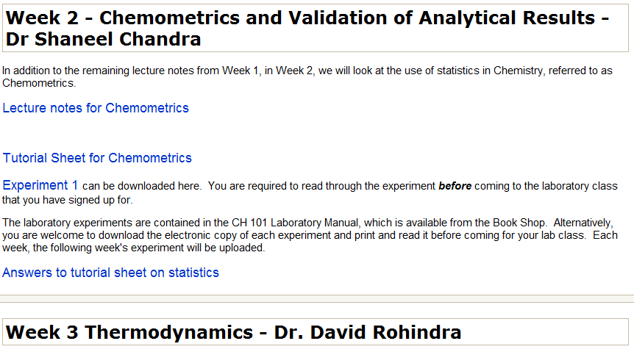
Moodle screenshots

Slide 12
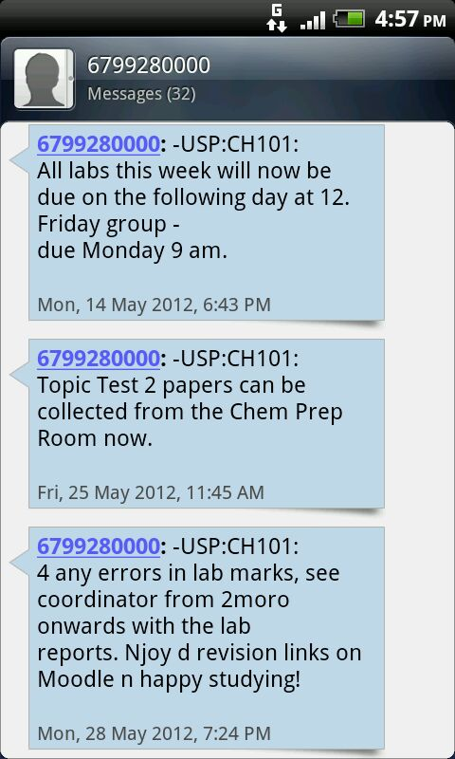
Mobile learning
Urgent notifications and alerts sent at no cost to either the student or the instructor.
CH 101 involves 10 practical sessions over five days and 374 students
Urgent occasional changes to schedules, deadlines communicated with ease.

Slide 13
Conclusions
Successful delivery of education content to students across twelve nations spread across the Oceania region.
Three enabling platforms principally: Satellite, the Internet & SMS (Mobile).
Multi-modal approach ensures students are not bereft of the university experience despite the mode they may have chosen to study through.

Slide 14
Acknowledgements
Office of the Dean
Office of the Associate Dean Learning & Teaching
Head of School
Academic colleagues
Students

