Slide 1
Building interactivity in a moodle course:
Case study of LW 110, semester 1 2015
Anita Jowitt
Staff seminar March 2015

Slide 2
Why build interactivity?
Concern that online students are isolated
  Interactivity to build community
Concern that online students do not work through material properly
  Interactivity to increase tracking of performance
    Self tracking & lecturer tracking
  Interactivity to increase feedback
    To students and to lecturer
  Interactivity to increase deep learning
Will interactivity increase results?
  Remains to be seen

Slide 3
Information delivery: non-interactive(ish)
Topic guides/readings designed like print based distance education material
  Study tasks
Lecture recordings
  But note, Emalus lectures are interactive
Powerpoints
Lecturer’s news/notices forum

Slide 4
Week by week release
Content can and does react to online activity
Content can and does react to student progress

Slide 5
Overview of interactive techniques
Online polls (not assessed)
Online questionnaires/surveys (not assessed)
Online discussion forums (not assessed)
Moodle messaging
SMS
Chat
Quickmail
Students encouraged to form face to face study groups
Online tests (assessed)
Grouped tutorial discussion forums (assessed)

Slide 6
NON-ASSESSED INTERACTIVITY

Slide 7
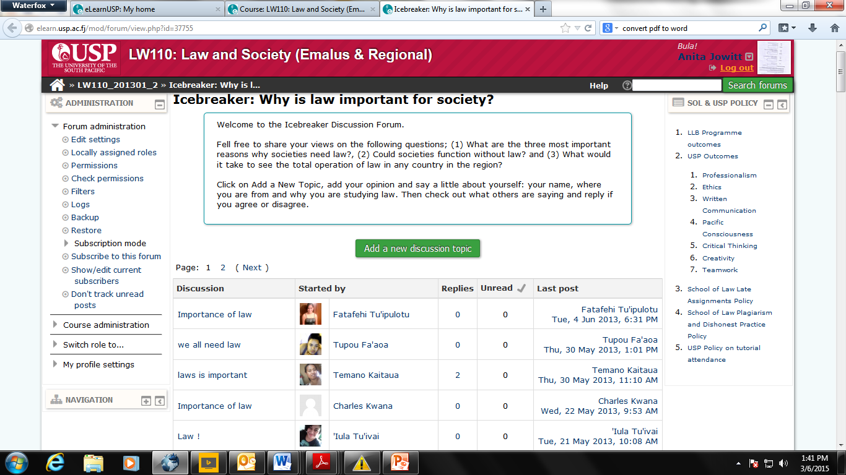
Why no icebreakers?

Slide 8
“Icebreakers” usually not interactive
Of example given (LW 110 2013) only 27/117 threads had a reply
Average number of replies per thread 0.22
Not an interactive community
  Students do not read each other’s comments
  Lecturers do not read/comment
Students “learn” that forums are not interactive

Slide 9
LW 110 ice-breakers
Lecturer post in social forum
  With replies to first few students to show I was reading
  As of 1/4/2015 intro thread I started has 83 posts
Online poll in topic 1
Online survey in topic 1

Slide 10
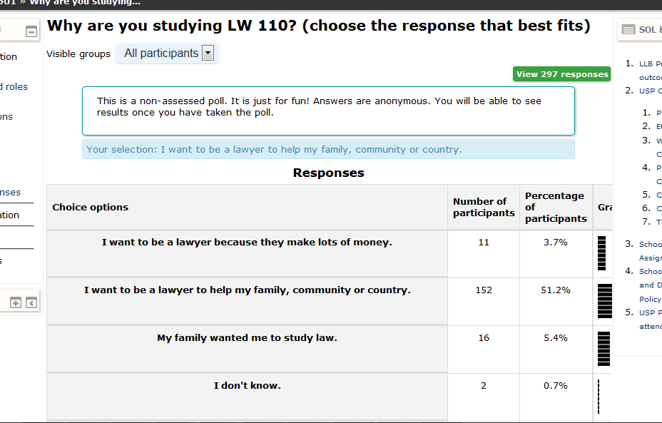
Poll

Slide 11
Advantages
Quick to set up
Can feedback into lecture
Lecture then feeds back into more online interactivity
  Students know their comments are contributing to the course

Slide 12
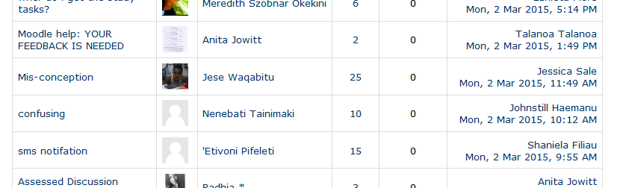
Example: misconception thread

Slide 13
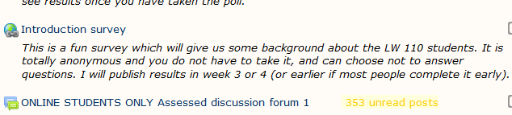
Surveys
Can use external site (anonymous & get manipulable statistics)
  https://www.soscisurvey.de/
Can use moodle (may not be anonymous to lecturer – although anonymous to students - and statistics less easy to use)

Slide 14
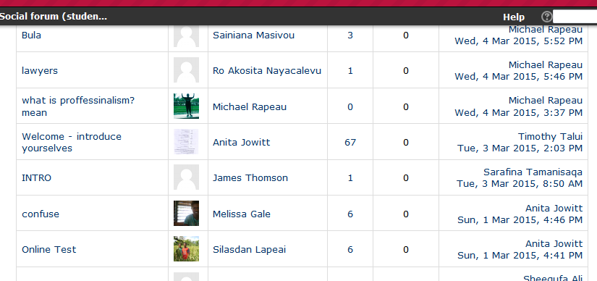
Surveys tie back to forums/teaching
In social forums 153 posts
Average replies per post 8
Biggest thread 67
Relates to topic 1 survey

Slide 15
Other things to get non-assessed social forums/Q&A forums working
Open before semester starts
Lecturer must reply to at least some messages
Lecturer may need to remind people to reply or thread messages
Lecturer must have ongoing presence

Slide 16
Once forums work students answer each other!
Q & A Forum: 32 threads (on 10/3)
Average number of replies 6.8 (on 10/3)
I check – but usually just have to confirm the answers other students have given

Slide 17
Encouraging participation
Moodle messaging | Information/ formative comment | One-on-one feedback | Asynchronous
SMS | Information |  | Asynchronous
Chat | Information/ formative comment | One-on-one or group feedback | Synchronous
Email | Information/ formative comment | One-on-one or group feedback | Asynchronous

Slide 18
Ongoing surveys/polls
Online polls (not assessed) | Formative self-assessment | Group feedback integrated into lectures | Asynchronous
Online questionnaires/ surveys (not assessed) | Formative self-assessment | Group feedback integrated into lectures | Asynchronous
Face to face study groups | Formative self-assessment | Students provide feedback to each other. | Synchronous

Slide 19
ASSESSED INTERACTIVITY

Slide 20
Assessed forums
Grouped – assigned by me
Research indicates optimal group size 7 – 10 students.
  My groups 12 – 15 students
Assigned questions – same as face to face tutorial
Group feedback – usually targeted to specific group - as well as individual messaging about specific issues

Slide 21
Questions as community building/ feedback loop
1. Introduce yourself to your group members - a bit about your background ,why you are studying law...
2. What do you think are the biggest challenges facing you as a law student that might prevent you from doing well? What do you think you can do to overcome these challenges?
3. How many of you talk with your lecturer (face to face, on the phone, in video-classes or on email)? And what advice would you give to lecturers to make them easier (less scary!) to talk to and more accessible to you?
4. What are you most looking forward to about doing LW 110 (or, if you are a new student, coming to USP)? And what are you most nervous about?
5. What advice would you give to another student about how to plan your work, and how to stay motivated to actually follow your plans?
6. Why do you think law is important for society? (This is not covered in course material, so you will need to think originally on this - but do not worry, there are no wrong answers)

Slide 22
Are these groups working?
Too early to tell
I can tell who is falling behind
I can and do personally message people with specific feedback (ie English)

Slide 23
Online tests
Weekly formative self-assessment
  Multiple attempts permitted
Quick to set up/automatically marked/instant feedback
Lets me know who is falling behind
Two tests are summative assessment
  One attempt only, delayed feedback, randomised questions

Slide 24
BUILDING COMMUNITY?
INCREASING PARTICIPATION?

Slide 25
Non-assessed forums
Course | Social forum | Q&A forum
LW 110 2015 | 48 threads, average length 4.8 posts Views 5265 | 55 threads average length 6.2 posts Views 7462
LW 110 2013 | 57 threads average length 1.5 posts Views not available | 48 threads average length 2.7 posts Views not available
Course differences:
  Student numbers: 2015 494/183 O; 2013 423/139 O
  Time period: 2015: 6.5 weeks; 2013 full semester

Slide 26
Polls, surveys
Activity | Views | Number completed
Topic 1 poll | 1138 | 311 (63%)
Topic 1 survey | 438 | 257 (on 10 March) (52%)
Topic 2 questionnaire | 415 | 97 (20%)
Topic 3 questionnaire | 573 | 103 (21%)
Topic 4 questionnaire | 225 | Online/internet out
Topic 6 poll | 2105 | 92 (19%)
Topic 7 poll | 126 | 35 (7%)

Slide 27
Tests, assessed forums
Activity | Views | Number completed
Topic 1 forum | 5469 | 151 students (83% - online only)
Topic 1 test | 4134 | 345 (70% - all)
Topic 2 forum | 4176 | 64 students (35%)
Topic 2 test | 5253 | 357 (72%)
Topic 3 forum | 4699 | Closed 27 MARCH – To be marked
Topic 3 test | 7936 | 396 (80%)
Topic 4 forum | 4146 | Closed 27 MARCH – To be marked
Topic 4 test | 5229 | 344 (70%)
Topic 5 forum | 2166 | 139 posts STILL OPEN
Topic 5 test – still open | 3286 | 246 (50%)
Topic 6 forum | 1115 | 93 posts STILL OPEN
Topic 6 test – still open | 305 | 145 (29%)
Topic 7 forum | 258 | 9 posts STILL OPEN

Slide 28
Student rating of usefulness
(103 respondents)
Topic guides | 4.5
Study tasks in the topic guides | 4.3
Tutorials/online tutorials | 4.1
Readings | 4.4
Lectures/Lecture recordings | 4.1
Powerpoints | 4.3
Non-assessed forums | 3.3
Non assessed activities (polls, surveys et cet) | 3.3
SMS notifications | 3.9
FALE study skills material | 3.8

Slide 29
But – data is richer
Responses | 1 | 2 | 3 | 4 | 5 | Total
Topic guides | 2 (2%) | 1 (1%) | 9 (9%) | 24 (24%) | 66 (65%) | 102
Study tasks in the topic guides | 3 (3%) | 6 (6%) | 9 (9%) | 25 (25%) | 59 (58%) | 102
Tutorials/online tutorials | 6 (6%) | 4 (4%) | 15 (15%) | 22 (22%) | 55 (54%) | 102
Readings | 1 (1%) | 3 (3%) | 12 (12%) | 25 (25%) | 61 (60%) | 102
Lectures/Lecture recordings | 7 (7%) | 3 (3%) | 13 (13%) | 26 (25%) | 53 (52%) | 102
Powerpoints | 2 (2%) | 5 (5%) | 9 (9%) | 33 (32%) | 53 (52%) | 102
Non-assessed forums | 14 (14%) | 16 (16%) | 24 (24%) | 24 (24%) | 24 (24%) | 102
Non assessed activities (polls, surveys et cet) | 16 (16%) | 11 (11%) | 26 (25%) | 26 (25%) | 23 (23%) | 102
SMS notifications | 11 (11%) | 7 (7%) | 13 (13%) | 22 (22%) | 49 (48%) | 102
FALE study skills material | 13 (13%) | 5 (5%) | 14 (14%) | 24 (24%) | 46 (45%) | 102

Slide 30
Access statistics by month
 | February | March
LW 110 2015 (494/183) | 73291 | 121618
LW 110 2013 (423/139) | 17611 | 45752
LW 111 (492/149)

Slide 31
Activity access
 | LW 110 (2015)
Topic 1 guide | 1482
Topic 2 guide | 1603
Topic 3 guide | 2138
Topic 4 guide | 1789
Topic 5 guide | 1652
Topic 6 guide | 822
Topic 7 guide | 326

Slide 32
WHAT ABOUT OTHER YEARS?
200 level 2015 data
Apologies for any misunderstanding of course content – this is a very quick overview and not based on lecturer self-assessments

Slide 33
Courses – overview of interactivity
 | LW 201 | LW 203 | LW 205
Number of students | 285/54 O | 277/42 O | 277/51 O
Non-assessed forums | Questions on the course Online students – share your thoughts here Online forum discussions News and announcements online students | ? | ?
Assessed forums | NONE – drop box for weekly individual tutorial answers | 10 tutorials | Weekly tutorial –
Other? | Icebreaker | ? | ?

Slide 34
Assessed tutorial differences
 | LW 201 | LW 203 | LW 205
Can read others contributions? | No | Yes | Yes
Marking criteria | No marks for discussing others posts | No marks for discussing others posts | Marks for engagement with other students, not dumping answers
Set up of forum | N/A | Students can start new discussions | Threading mandatory - lecturer controlled
Question type | Summative rather than discussion | Summative rather than discussion | Summative rather than discussion
Student discussion in practice | N/A | No | Some – but lots of dumping answers Tutorial 1 lots of “off topic discussion”
Feedback | ? None are marked via moodle | Class answer guide posted –some contain discussion of answers received & common mistakes | ? No comments on the threads

Slide 35
Assessed tutorial participation
 | LW 201 | LW 203 | LW 205 (number of posts in thread)
# Online | 54 | 42 | 51
1 | 41 | 40 | N/A
2 | 47 | 37 | 37
3 | 42 | 14 | 37
4 | 34 | 13 | 46
5 | None | 25 | 37
6 | 0 (closes 15 April) | 0 (closes 7 April) | 25
7 | None? | Not yet released | 0 (closes 3 April)

Slide 36
Group communication?
 | LW 201 | LW 203 | LW 205
SMS | Not added | 0 | 0
Quickmail | 0 | 0 | 0

Slide 37
Access statistics by month
 | LW 201 | LW 203 | LW 205
February | 23317 | 17180 | 18907
March | 34634 | 36409 | 26209
NOTE: Activity access comparisons not done because courses do not have consistent approach to providing information.
Drop-off in access to activities is an important dimension to consider.

Slide 38
ISSUES/ETHICS/Research outputs

Slide 39
Issues from a teacher’s perspective
TIME
  Ask at the end of the semester about the cost/benefit analysis
Unreliable internet
Technical (moodle) know-how
  You need to know how to use more than 1 technique
  You need to relate techniques to each other
  Marksheet complexity
  You need to be able to “workaround” when moodle does odd things
    Students need to be telling you when things are not working
Distance education design know how
Classroom teaching know how
Ethics

Slide 40
Feedback/revision issues
JUST DISCOVERED TODAY 2/4/2105
Once an activity has closed students cannot access it
  All the tutorial discussion is lost from view
  My feedback – getting people to go in and look at each others’ posts, is therefore a waste of time.
My workaround
  Once a forum is closed and marked I will reopen – with a clear message that further postings will not be marked
  I need to figure out the technical side of the tests – possible workaround, putting all questions and feedback into a word document

Slide 41
Ethics: reflective teaching practice or action research?
DVC research: “Since the research POLLS, SURVEYS, QUESTIONNAIRES, TUTORIAL QUESTIONS (however it is used/communicated) involves your own students, and there is therefore potential for a conflict of interest or for students to feel that there is coercion to answer or even to answer in certain ways (I am not suggesting there is, but there is a risk of that perception at least), I think it would be a good idea to get approval at FRC level by submitting the screening questionnaire and a description of the research and control measures in place (e.g. anonymity and how you seek permission). This will cover you if there was ever a complaint, otherwise you may be exposed.
FRC can either approve or ask for more detail and/or pass on to UREC if they assess it to have a significant risk.
Although there is a case to say that this is not research but good teaching practice, it will be a relatively small investment for peace of mind.”

Slide 42
Journals to publish in?
Law
  Law Teacher (C in ERA list)
  Legal Education Review (C in ABCD list)
Education
  Directions (USP journal) Ranking probably C
  Online or distance education journals tend to be C
  More B, A, A* in general areas

