Slide 1
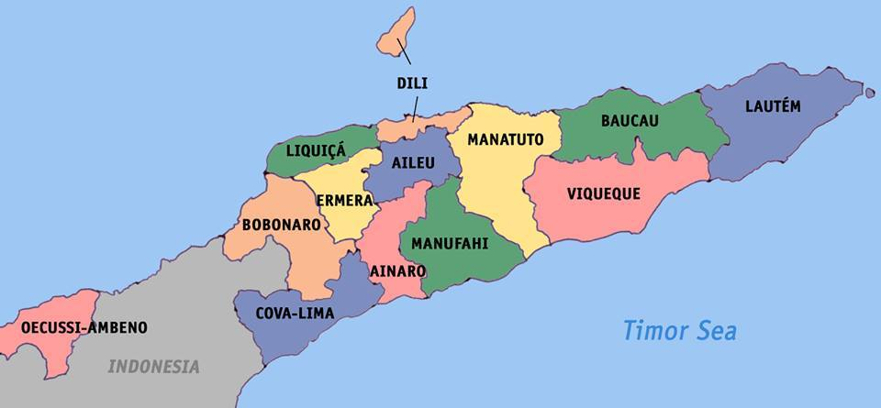
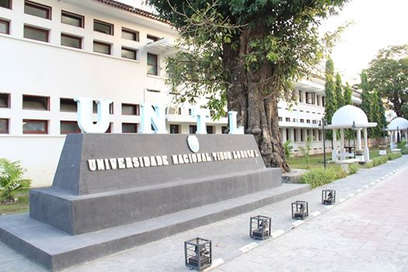
Outline of this presentation
Part 1: Teaching Practice at National University of Timor Leste, Dili
Part 2: Evaluation of ED300 Practicum – Online mode (2015)

Slide 2
Part 1: Teaching Practice at UNTL
Length: 3 months
Assessment: minimum 4 times by University staff
Who assesses: The Faculty staff assess their own students
Uniform: The trainees wear black & white during teaching practice
Associate Teachers’ workshop: Thorough briefing in each school prior to Practicum

Slide 3
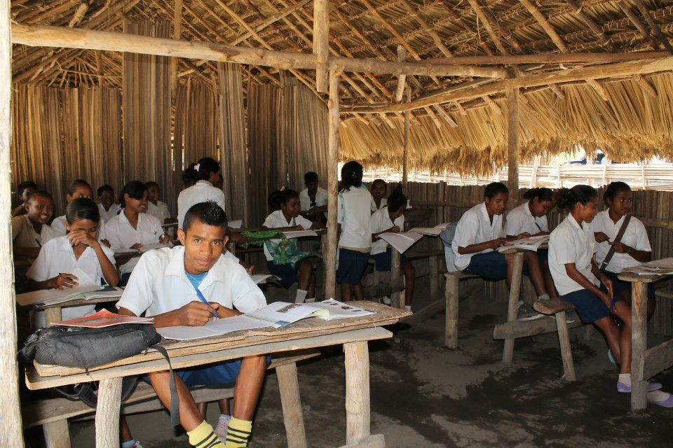
Practicum evaluation by the ATs: done in each school after Practicum is over
Practicum evaluation by the trainees: written evaluation form filled towards the end of Practicum
A rural classroom in Timor Leste

Slide 4
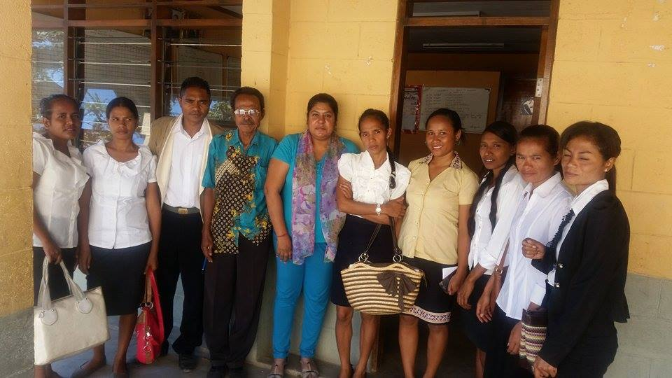
What can we incorporate @ USP?
AT’s workshop to be made compulsory – this can happen in semester 2 when the Practicum staff are less loaded with assessments. This visit can also be used to get a feedback from the ATs on Semester 1 Practicum. As it is we do visit schools in semester 2 to give remunerations.
What are your views on the trainees wearing black and white or any other colour combination that will make them stand out? It can have its advantages and disadvantages.
Teacher trainees with their
Head Teacher in a Primary
School in Dili, Timor Leste
(notice their black & white
uniform)

Slide 5
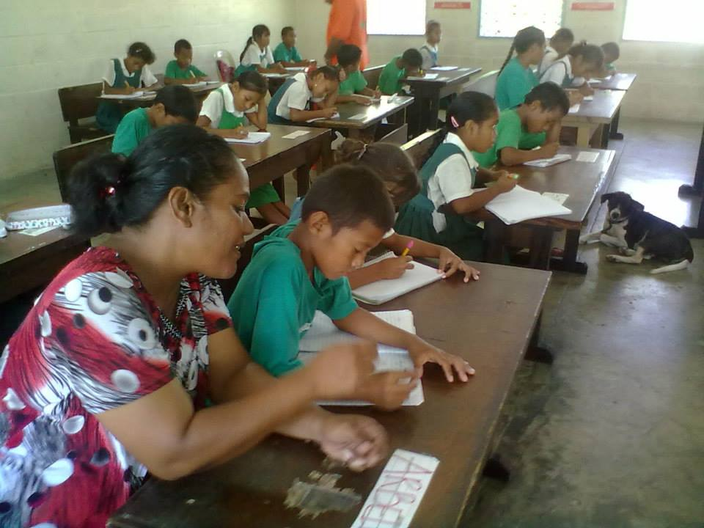
Part 2: Evaluation of ED300 Practicum – Online mode (2015)
Background information: This year Practicum was implemented through online mode. There was no print material.
Total number of students in Module 2: 245
Country spread:
Fiji 180
Solomons 21
Vanuatu 8
Kiribati 10
Tonga 6
Samoa 1
Cook Is 6
Marshall Is . 13
Trainee teacher teaching in Marshall Islands
Total number of students in Module 1: 105
Total number of students in Module 1 & Module 2 = 350

Slide 6
SUMMARY of Module 2 Student spread - ED300 : 2015 (Semester 1)
MODULE 2
Country | Secondary | Primary | ECE | SIE | Total | Total
Fiji
* Central | 94 | 20 | 4 | 3 | 121
* Western | 16 | 12 |  |  | 28
* Northern | 22 | 8 | 1 |  | 31
TOTAL | 132 | 40 | 5 | 3 |  | 180
Solomon Is. | 19 | 1 | 1 |  | 21 | 21
TOTAL | 19 | 1 | 1 |  |  | 21
Vanuatu | 8 |  |  |  | 8
TOTAL | 8 |  |  |  | 8 | 8
Kiribati | 10
TOTAL | 10 |  |  |  |  | 10
Tonga | 3 | 3
TOTAL | 3 | 3 |  |  |  | 6
Samoa | 1
TOTAL | 1 |  |  |  |  | 1
Cook Islands | 1 | 3 | 2 |  |  | 6
TOTAL |  |  |  |  |  | 6
Marshall Is |  | 12 | 1 |  |  | 13
TOTAL |  |  |  |  |  | 13

Slide 7
General problems faced by students
Internet connection especially in rural areas of Viti Levu, Vanua Levu and the Regions.
Email from Center Coordinator, Cook islands:
“Barbara withdrew, due to the problems she faced with the internet connection. Leah George withdrew also because of the poor internet connection especially since she couldn’t get to work online. Ngaruaine faced similar issue with the internet connection at her Mangaia school therefore she was not able to go online to print out the handbook. This was sent to her by the office. The 5 students in Aitutaki were also having the same problems with the internet connection. The whole island was facing similar problems which caused the internet connection to go on and off, most times. The students were not able to work on Moodle or online as regular as they would have wanted. Most of them wanted to withdraw from the ED300 course because of this problem, but the office people managed to print out copies of the handbook and deliver that to them. I was sent over to help and see that they were managing well with the course work”.

Slide 8
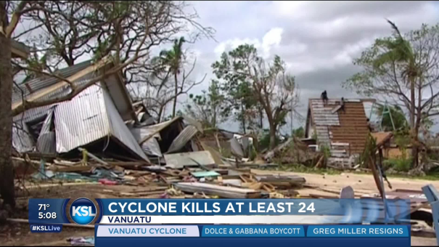
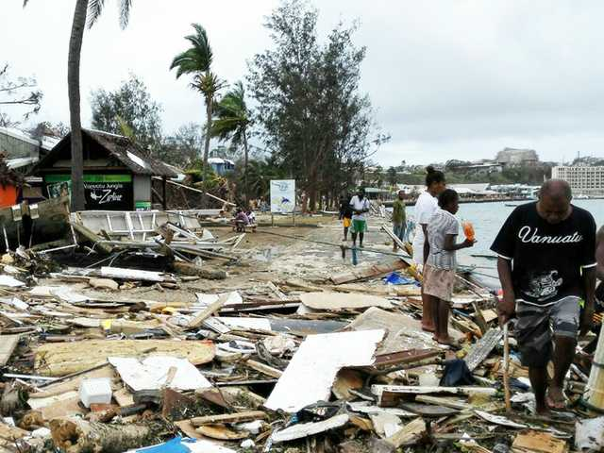
Cont.
Expensive internet access: due to slow accessibility the internet charges escalated for most students especially in the regions
3. Expensive to scan and upload documents like: assignments, 10 copies of lesson observations, 10 copies of lesson plans, pictures. Cost of scanning each page ranged from $1.00 - $2.00 in Fiji. Cost in regions not available.
4. Students affected by the cyclone in Vanuatu

Slide 9
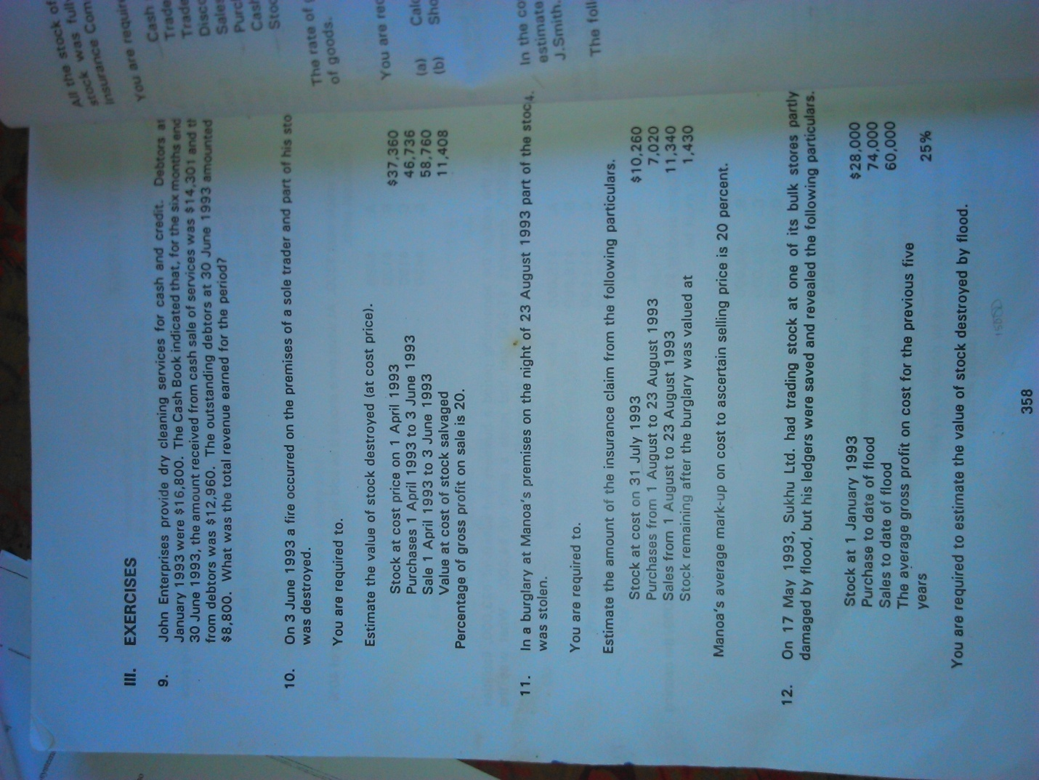
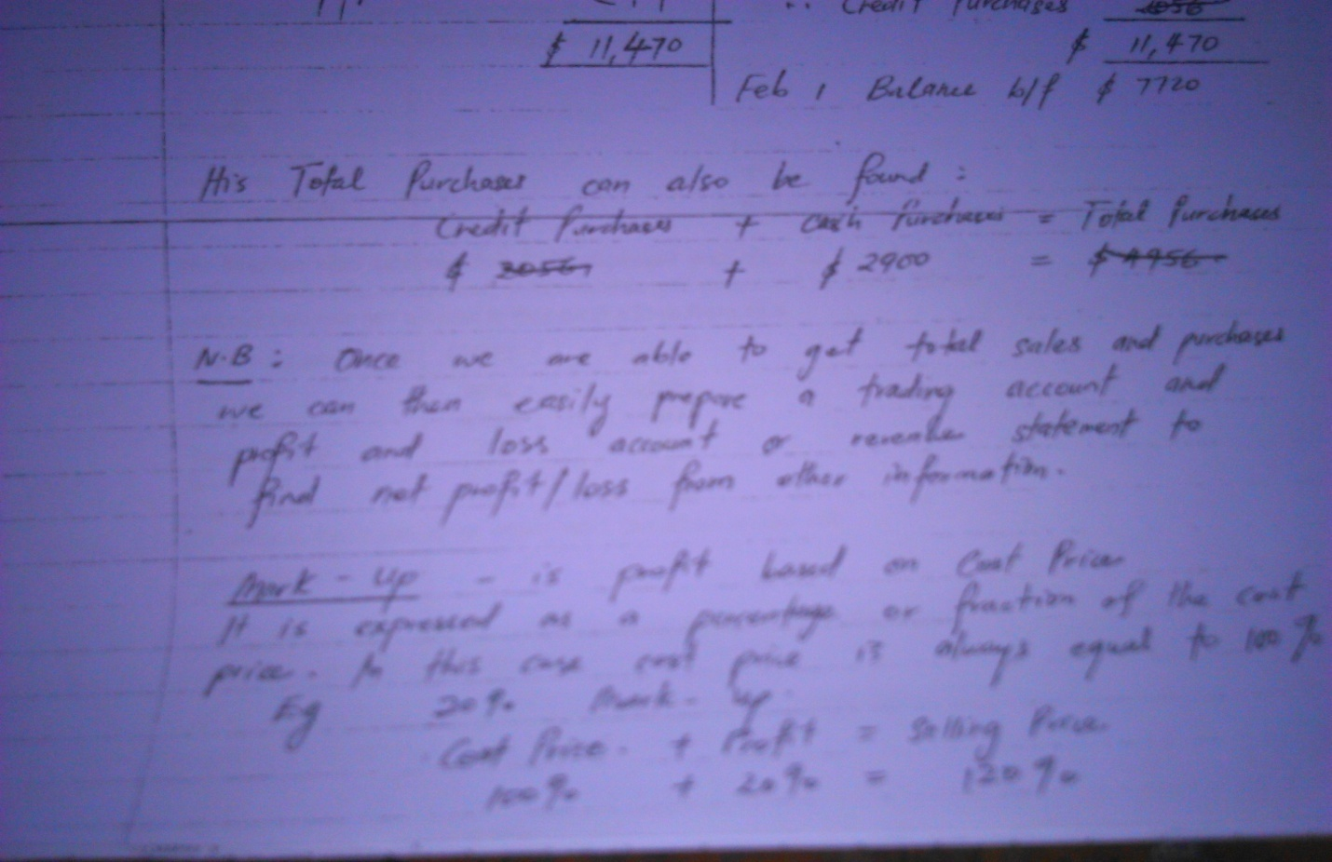
Solutions sought by students
Some students took camera shots of their assignments & other documents and uploaded on Moodle to save cost. How to mark them?
Students wrote to the course Coordinator asking for assistance (wherever I could assist them I did but most times their emails were forwarded to Mr. Eroni Racule of CFL and he sorted out their specific problems)
Most Labasa and regional students were given the choice of handing in all documents in the Practicum Folder due to poor internet accessibility

Slide 10
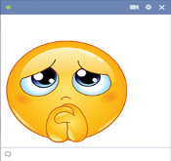

Students’ emails
Problem: ‘My AT’s assessment form is 29.3mb. Dropbox says I can upload 20 mb only. I cannot upload, what should I do?’
Solution: Eroni enabled more space for submission.
Problem: ‘I uploaded at 4:46pm but the uploading system said that I am late, after all the due time is 10 something pm tonight’.
Solution: we left all assignment drop box open till the last due date.
Problem: ‘I submitted my assignment on the due date. Somehow, there is an error saying that the due date for this assignment had passed and it will not accept late assignments. Please fix this problem for me’.
Problem: ‘when will we receive the marks for our assignments. I haven’t seen any. Please respond immediately………….’
Solution: There was no marker till the end of Practicum. All markings were done after the practicum was over.

Slide 11




Cont.
Problem: ‘I am having problems submitting my school coordinator’s report. Turn-it-in requires more than 100 words so that it can detect the similarity rate. It says to contact the lecturer. Turn-it-in cannot detect similarity rate for scanned documents’.
Problem: ‘I just realized I have uploaded a wrong file. Could you help me find a way to upload my correct file? I do hope that you will help me’.
Problem: ‘Can you please explain how can we submit our e-Portfolio final page for marking’.
Problem: ‘The attachment for AT's assessment is 3 but we have to upload 4 submissions’.
Problem: ‘Can you please reopen the drop box for Task 3 (1 - 5). I forgot to upload my lesson observations and I can't upload it on the second one (6 - 10) as the Moodle system cannot add more files after submitting 5 lesson observations’.
Problem: ‘I have made a mistake in uploading one of my documents. Can you please revert my submission. It would be a great help’.
Enquiry: ‘Do we have an exam for this course?’

Slide 12



General problems faced by students
‘We need a face to face tutor who is present all the time in office to solve our problems’.
‘Creating Mahara page and uploading was difficult’.
‘Getting access to the internet to read updates and announcements’ (network problem).
‘Taking more units face to face at USP – took toll on time’.
‘Scanning and uploading assignments on Mahara - an expensive
exercise’
6. ‘Unfriendly AT’s and too many supervisions given’.
7. ‘Paying for teaching aids/resources and bus fares – too expensive’.

Slide 13
Problems encountered by Mr.Eroni Racule, CFL
Students uploading wrong items into the drop boxes & then asking if those could be removed so that they may be able to upload the correct versions (most common problem)
Students technical skills: combining scanned documents into one file instead of several files, they picked this up really quickly and were able to adjust themselves in the next submissions and were able to combine several scanned images into one file.
Some of the scanned images produced big file sizes that Moodle could not take, this could be addressed when scanning and selecting the correct output format.
Importing files from Moodle to Mahara was difficult for some students
Limited number of files allowed to upload, this was adjusted after queries came in from students.

Slide 14

Problems encountered by the markers
pdf assignments!
Most students uploaded assignments both in the drop box and in the e-Portfolio created in ‘Mahara’ in Moodle so lot of time was wasted in looking for the assignments.
Photo shot assignments – faced difficulty in marking.
Firefox and Mozilla issue. Some trainees’ files did not appear or open. Had to get the IT staff to resolve such problems. Took more time due to unavailability of IT staff whenever the need arose.
Some trainees thought they had uploaded their documents but markers found nothing in their folders! These students were given a call and were asked to send soft copies of their assignments to the practicum coordinator because the Moodle drop box had finally closed!

Slide 15
Recommendations
Trainees should be given a print copy handbook as well besides the Moodle support due to the numerous documents given in the handbook that they need to download and use. It was noticed that the trainees failed to go through the complete Handbook because it was online. One reason is lack of internet access. Other of course is laziness. Very few students actually printed the Handbook. A print Handbook is easily accessible as and when needed.
Reduce the number of documents to be uploaded (e.g. 5 instead of 10 lesson observations and 8 instead of 10 lesson plans).
Make school-based action research compulsory keeping in mind RSD
Associate teachers workshops to be compulsory each year to iron out all school-based practicum issues.
Practicum Office to facilitate trainees with all the assessment forms for the Associate Teachers and the School Coordinators. There is also a need to hand in a ‘Resource Kit' to the students (more info in next slide)

Slide 16
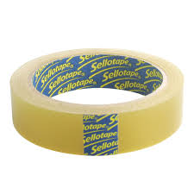



Resource Kit
The Resource Kit to be inclusive of:
10 newsprints
5 vanguard sheets
1 Blu-Tack
1 sellotape
I pkt pental pens
1 pair of scissors

Slide 17

Conclusion
ED300 online mode was a great experience for both the students and the lecturers.
Revisions to the course will be made to suit the needs of the students based on the problems they faced.
One aspect that comes out clearly is that the students need to be equipped with a print copy of I/A Handbook. This can be a photocopy print.

