Slide 1
Overview
Topic: Student teachers’ perceptions about Teaching Practice: a case study of the University of the South Pacific
Study was undertaken in 2013
Methodology: Teaching Practice was evaluated by requesting students in Fiji schools to respond to a designed questionnaire
65/100 students responded

Slide 2

Aim of the study: to explore the pre-service students’ perceptions about teaching practice
Hypothesis : While subject knowledge often is no problem for the students there seems to be less focus on the development of teacher skills in the teacher training program at USP

Slide 3
Organisation of Teaching Practice at USP
Teaching practice is done in two phases; the first 3 weeks (Module 1) is carried out in the third year of study and the second phase (Module 2) is completed in the final year and lasts for fourteen weeks, thus, a total of seventeen weeks
Module 1 is always home based
Module 2 usually involves schools around Suva/Nausori corridor (inclusive of Navua, Namosi and Tailevu)

Slide 4
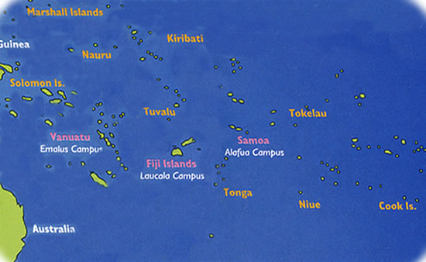
THE UNIVERSITY OF THE SOUTH PACIFIC

Slide 5
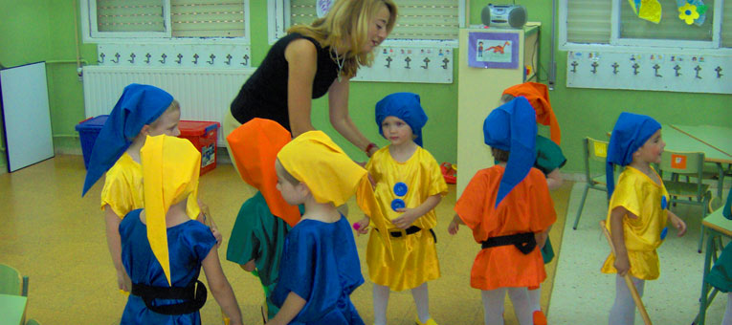
2013 Practicum
Module 2 students were instructed to pick schools nearer to their homes for teaching practice
As a result, students were spread all over Fiji and the regions
Practicum duration was 14 weeks (Term 1 only)
There was no Module 1

Slide 6
Cont.
All students were allowed to enroll for one more online course besides ED300
Only graduating students doing face to face course(s) were allowed to stay back in Suva for the practicum
A few students did a total of 3 units because they had to graduate and their sponsors wanted them to finish the program in the given time schedule

Slide 7
Questionnaire structure
A total of 19 closed format questions were given in the form of multiple choice
Two of the 19 questions had an added open-ended question that gave an opportunity to the students to express their opinions in a free-flowing manner.

Slide 8

Findings
In most cases the teacher trainees were quite satisfied with the teacher training program provided at USP
However, there are areas where a better finishing in terms of polishing the skills of teaching can be done

Slide 9
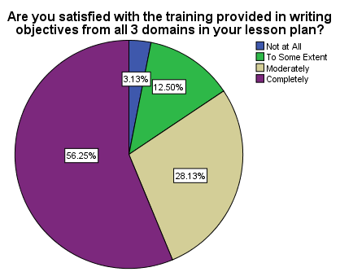
ANALYSIS

Slide 10
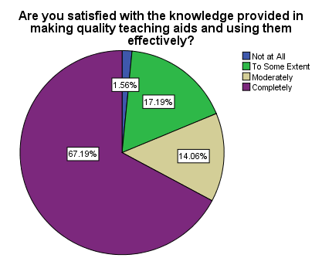
Q2

Slide 11
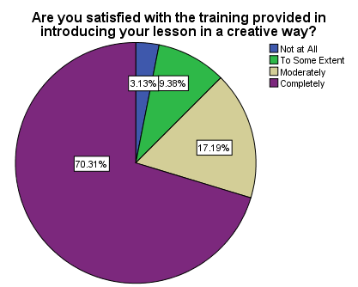
Q3

Slide 12
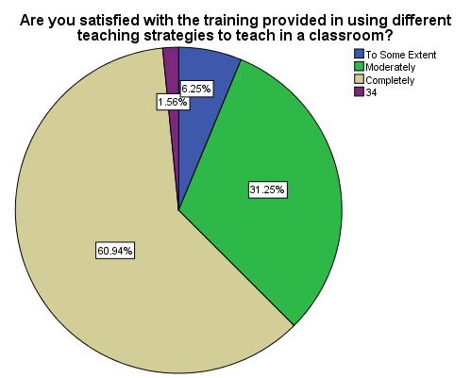
Q4

Slide 13
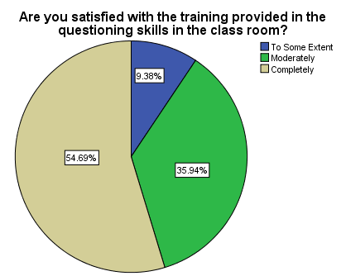
Q5

Slide 14
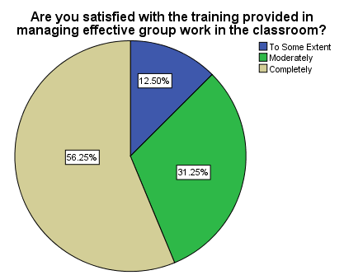
Q6

Slide 15
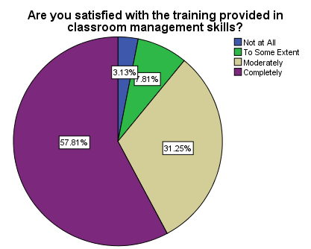
Q7

Slide 16
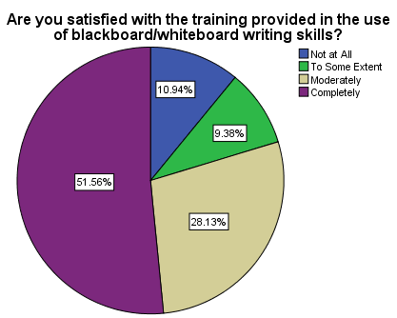
Q8

Slide 17
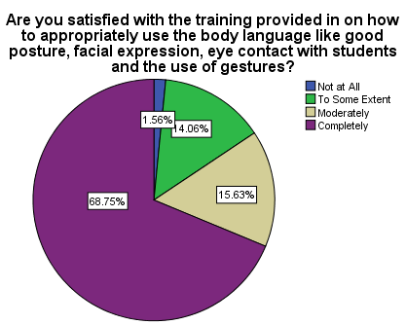
Q9

Slide 18
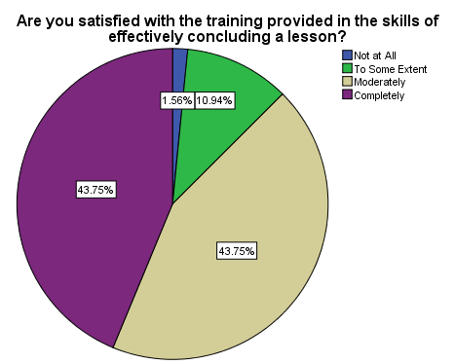
Q10

Slide 19
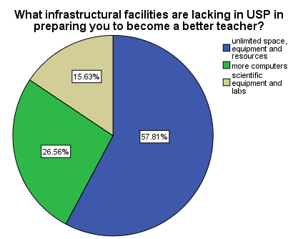
Factors that limited the students’ performance during teaching practice

Slide 20
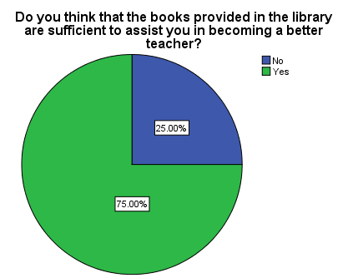
Cont.

Slide 21
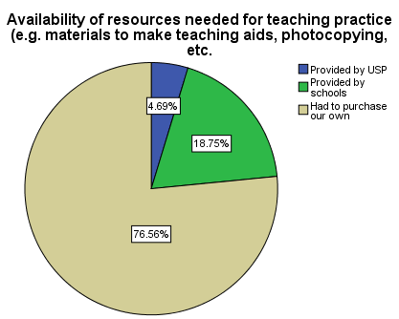
Cont.

Slide 22
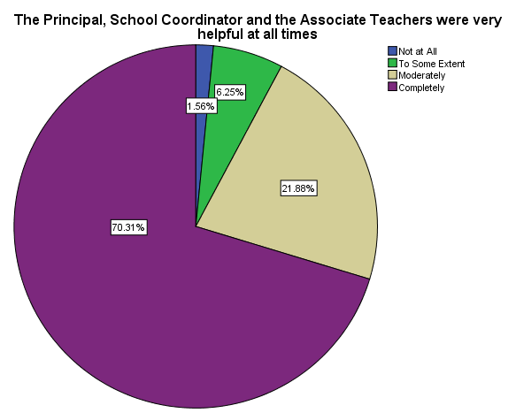
Cont.

Slide 23
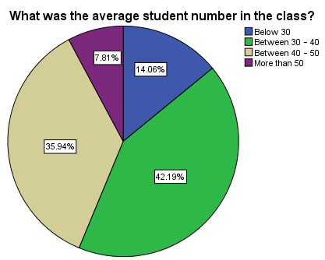
Cont.

Slide 24
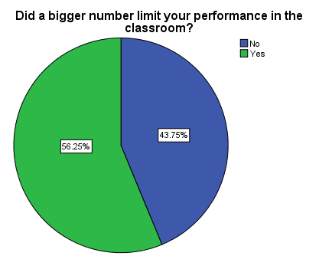
Cont.

Slide 25
How did a bigger number in class limit your performance?
Less movement, congestion
Not confident with a bigger number
Difficulty in classroom management
Couldn’t complete all planned activities
Difficult to give individual attention
Lost concentration due to excessive noise
Took time settling class before teaching
Couldn’t practice variety of teaching strategies
Took more time correcting students’ work

Slide 26
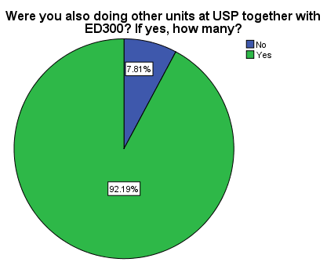
Cont.

Slide 27
Were you doing other units besides ED300?
56 students were doing one more unit besides ED300.
Some students were enrolled for 2 more units besides ED300. These were graduating students who had enrolled for courses that were not offered in semester 2
4 respondents were enrolled for ED300 only

Slide 28
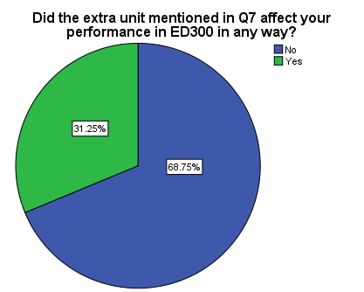
Cont.

Slide 29
How did the extra unit(s) affect your performance in ED300?
Too much work load, struggled with assignments
Too much to do in ED300, other units had assignments too but ED300 demanded a lot more
Assignments had same due dates for different courses
ED300 was too challenging, took too much time
Too many assignments in all the courses
Had to attend to lab/tutorial sessions; faced traffic problems
Could not meet deadlines for all assignments.

Slide 30
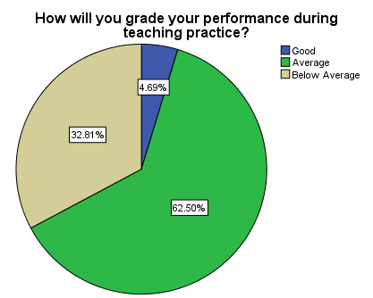
Cont

Slide 31
Conclusion
92.19% students enrolled for other units besides ED300. We have no control over students’ enrolment because they have a program to follow and they follow a timeline usually given by their sponsors. Different schools of USP have their own set program for each semester. Unless we fine tune the whole teacher training program by liaising with other schools of USP, we cannot dictate to students how many units to enroll while doing ED300

Slide 32
Cont.
57.81% students expressed their concern on the unlimited space , equipment and resources provided at USP in preparation for teaching practice.
25% students felt that the books provided in the USP Library was insufficient to assist them in becoming better teachers.
Students graded their own performances as such: 4.69% – Good; 62.50% – Average; 32.81% – Below average. This clearly tells us that there is a lot more that USP can do so that the students can rate their performances better.

Slide 33
Recommendations
allocate more time of micro teaching on the skills of teaching
identify relevant texts on teaching practice skills for students' reference in the library
redesign assignments in Module 1 that challenge students to focus/note the skills of teaching during their three weeks of stay in the schools.

Slide 34
Cont.
appoint a full time instructional media person who can liaise closely with students on constructing/making of teaching aids and on refining the teaching skills. In addition refurbish a working environment where students can work on their instructional materials
A relook into ED250 and ED350 courses to focus more on the classroom teaching skills especially in the workshops (???????)

Slide 35

The End Thank you

Slide 36
Points to note
Do a comparative study of same questionnaire on this years’ trainees
Do the same for beginning teachers
Limitations: these students had 14 weeks of Teaching practice only –no
Online e-books – were they available as stds were home based
Present- kusum, vinata, hem, jeremy, steven, sainiana, shikha, Pride gora, tema, akhila, mita
Missing – sala, ledua, francis, sereima, govinda, robmo,subhash,
Apologies - konia

